Slide 1

CSS Architecture – BEM
Block Element Modifier
SoftUni Team
Technical Trainers
Software University
https://softuni.org

Slide 2
Table of Contents
What is BEM?
Benefits
Problems with BEM
Naming - BEM
BEM in Action
Notes:
2

Slide 3
Have a Question?
sli.do
#front-end
Notes:
3

Slide 4

Block, Element, Modifier Methodology
Notes:
4

Slide 5
What is BEM?
A popular naming convention for classes in HTML and CSS
The goal is to help developers better understand the relationship between the HTML and CSS in a given project
/* Block component */
.btn {}
/* Element that depends upon the block */
.btn__price {}

Slide 6
What is BEM?
Parent Element - .btn{}
Child Elements (denoted by two underscores following the name of the block) .btn__price { }
Modifiers - .btn--orange{}
/* Modifier that changes the style of the block */
.btn--orange {}
.btn--big {}

Slide 7
The Markup
<a class="btn btn--big btn--orange" href="#">
<span class="btn__price">$9.99</span>
<span class="btn__text">Subscribe</span>
</a>
It's easy to understand:
Which classes are responsible for what
How they depend on one another
Without writing CSS, developers are potentially capable of creating different combinations of buttons by changing a class in the markup

Slide 8

BEM – Demo
<a href="#" class="btn">
<span class="btn__text">Standard button</span>
</a> <a href="#" class="btn btn--orange btn--big">
<span class="btn__price">$6</span>
<span class="btn__text">Big button</span>
</a> <a href="#" class="btn btn--blue btn--big">
<span class="btn__price">$4</span>
<span class="btn__text">Big button</span>
</a> <a href="#" class="btn btn--green btn--big">
<span class="btn__price">$9</span>
<span class="btn__text">Big button</span>
</a>

Slide 9
BEM – Demo
/* Block */
.btn {
text-decoration: none;
background-color: white;
color: #888;
border-radius: 5px;
display: inline-block;
margin: 10px;
font-size: 18px;
text-transform: uppercase;
font-weight: 600;
padding: 10px 5px;
}
/* Element */
.btn__price {
background-color: white;
color: #fff;
padding-right: 12px;
padding-left: 12px;
margin-right: -10px;
font-weight: 600;
background-color: #333;
opacity: .4;
border-radius: 5px 0 0 5px;
}
/* Element */
.btn__text {
padding: 0 10px;
border-radius: 0 5px 5px 0;
}
/* Modifier */
.btn--big {
font-size: 28px;
padding: 10px;
font-weight: 400;
}
/* Modifier */
.btn--blue {
border-color: #0074D9;
color: white;
background-color: #0074D9;
}
/* Modifier */
.btn--orange {
border-color: #FF4136;
color: white;
background-color: #FF4136;
}
/* Modifier */
.btn--green {
border-color: #3D9970;
color: white;
background-color: #3D9970;
}
body {
font-family: "fira-sans-2", sans-serif;
background-color: #ccc;
}

Slide 10

Why Should We Consider BEM?
Notes:
10

Slide 11
Modularity
Block styles are never dependent on other elements on a page
Never experience problems from cascading
Also get the ability to transfer blocks from finished projects to new ones

Slide 12
Reusability
Composing independent blocks in different ways, and reusing them intelligently, reduces the amount of CSS code that you will have to maintain
With a set of style guidelines in place, you can build a library of blocks, making your CSS super effective

Slide 13
Structure
BEM methodology gives your CSS code a solid structure that remains simple and easy to understand
.button {
display: inline-block;
padding: 7px 12px;
border: 1px solid #D5D5D5;
background-image: linear-gradient(#EEE, #DDD);
font: 700 13px/18px Helvetica, arial;
}
.button--state-success {
color: #FFF;
background: #569E3D linear-gradient(#79D858, #569E3D) repeat-x;
border-color: #4A993E;
}
.button--state-danger {
color: #900;
}

Slide 14

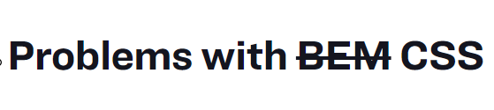
Break from BEM Rules
Notes:
14

Slide 15
Breaking BEM Rules
Looks like it has parts of BEM going on, but it’s NOT BEM
It has:
Nested Selectors
The modifier doesn't describe what's going on
A block (such as .nav) should never override the styles of another block or modifier (such as .btn--orange)
.nav .nav__listItem .btn--orange {
background-color: green;
}

Slide 16
Breaking BEM Rules
Breaking BEM Rules goes for HTML, as well
The problems:
Never override modifiers in an unrelated block
Avoid making unnecessary parent elements when the child can exist by itself
<a class="btn" href="#">
<div class="nav__listItem">Item one</div>
<div class="nav__listItem">Item two</div>
</a>

Slide 17
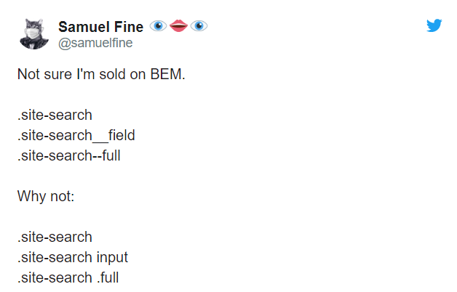
Naming Conventions
Notes:
17

Slide 18
Naming – BEM
It's not necessary to use double-underscores or double-dashes while naming
In the SMACSS methodology, you're likely to find a CSS class name with three letters
Modifiers then follow the module name with a hyphen:
.btn { } /* Example Module */
.btn-primary { } /* Modifier of the btn class */
.btn.is-collapsed { } /* Btn Module with State */

Slide 19
Naming – BEM
In OOCSS, blocks are similarly generic:
/* Example Module */
.mod { }
/* Part of Module */
.inner { }
/* Talk Module */
.talk { }
/* Variation of part inside Module */
.talk .inner { }

Slide 20

Practical Exercises
Notes:
20

Slide 21
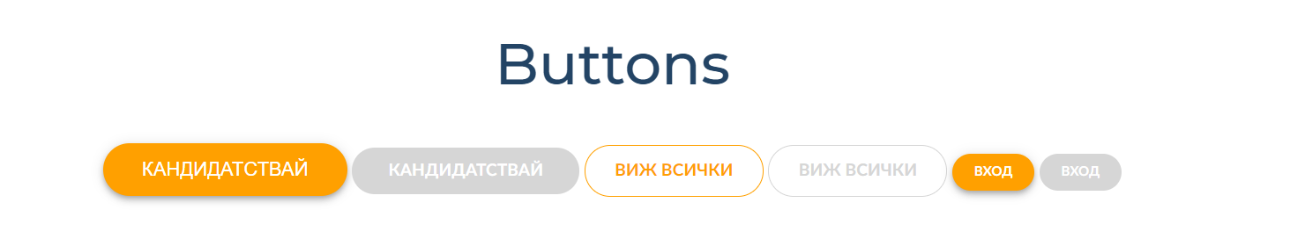
Buttons – Design Guidelines
Create a web page using the BEM methodology like the following:
Use the following design guideline

Slide 22
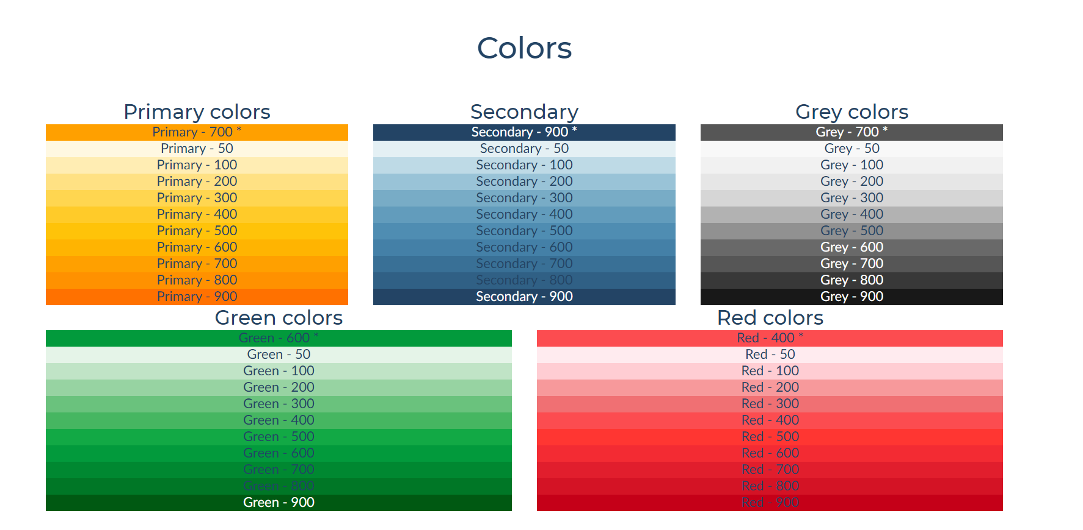
Colors – Design Guidelines
Create a web page using the BEM methodology like the following:
Use the following design guideline

Slide 23

Summary
What is BEM?
Benefits - Modularity, Reusability, Structure
Problems with BEM
Naming - BEM
BEM in Action
Notes:
23

Slide 24
Questions?
Notes:
24

Slide 25














SoftUni Diamond Partners

Slide 26

License
This course (slides, examples, demos, exercises, homework, documents, videos and other assets) is copyrighted content
Unauthorized copy, reproduction or use is illegal
© SoftUni – https://softuni.org
© Software University – https://softuni.bg
Notes:
26

Slide 27
Trainings @ Software University (SoftUni)
Software University – High-Quality Education, Profession and Job for Software Developers
softuni.bg
Software University Foundation
softuni.foundation
Software University @ Facebook
facebook.com/SoftwareUniversity
Software University Forums
forum.softuni.bg
Notes:
27

